Slide 1
Dynamics in Youtube Recommendation:
Are there filter-bubbles?
Presenter: Manqing Ma
10/24/2022
FNS Class Presentation

Slide 2
Initiatives, dataset and some related works

Slide 3
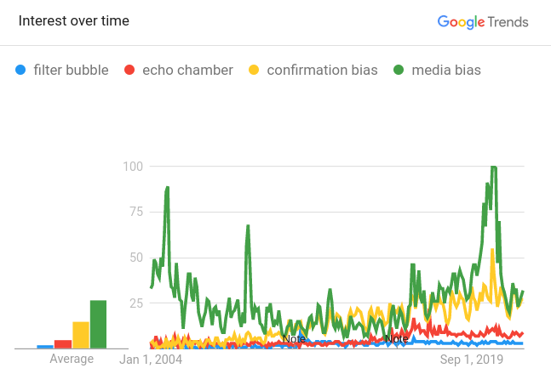
How the notion of “Filter bubble”/“Echo chamber” got the public attention
Filter bubble / Echo chamber
“...In December 2009, Google began customizing its search results for each user. Instead of giving you the most broadly popular result, Google now tries to predict what you are most likely to click on.”
– “The Filter Bubble: How the New Personalized Web Is Changing What We Read and How We Think”, May 2011, Eli Pariser
Media bias
Confirmation bias
Filter bubble
echo chamber

Slide 4
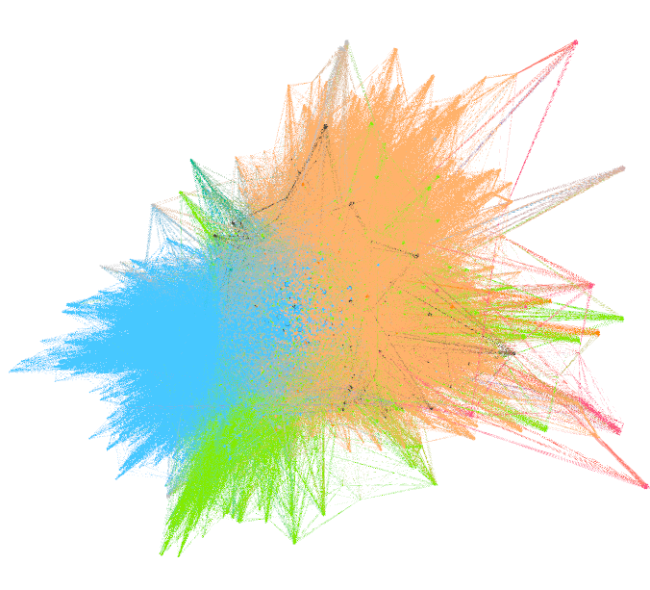
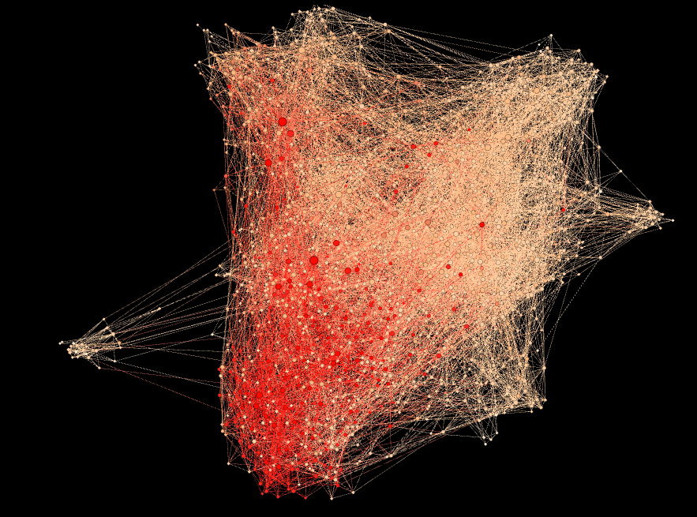
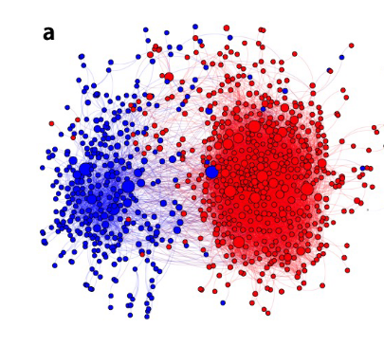
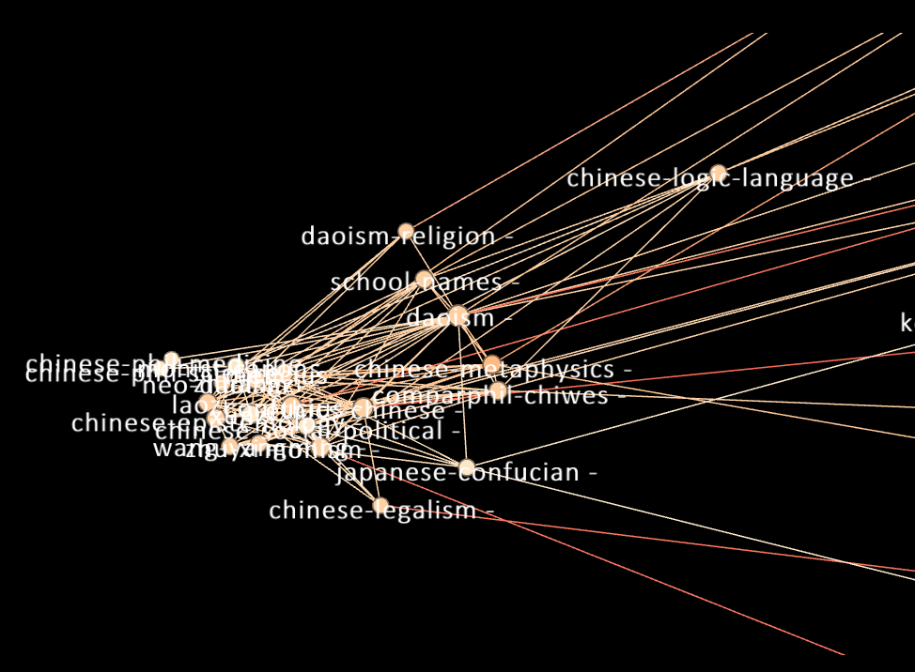
“Filter bubble” is naturally ubiquitous in content and preferences
Literature writer – readers’ preferences network communities: Nodes - Writers, Edges - “reader who likes xx also likes xx”
(Data: Literature-map.com – Random walk from a single author and merging the nearest-nbrs networks. ~12000 writers. Two giant communities detected.)
Fig. 1 (a) Visualization of the co-purchase network among 583 liberal (blue) and 673
conservative (red) books
Shi, Feng, et al. "Millions of online book co-purchases reveal partisan differences in the consumption of science." Nature Human Behaviour 1.4 (2017): 1-9.
Stanford Encyclopedia of Philosophy(SEP) network: Nodes - entries, Edges – hyperlinks

Slide 5
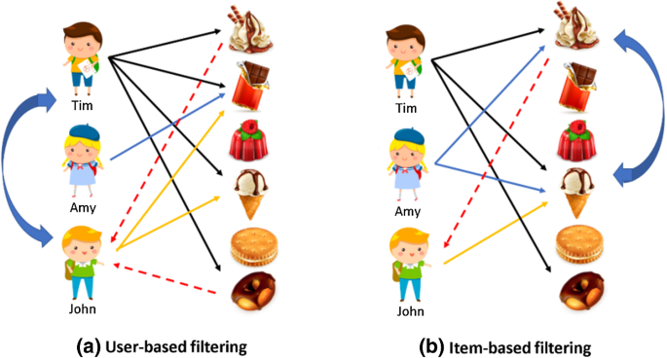
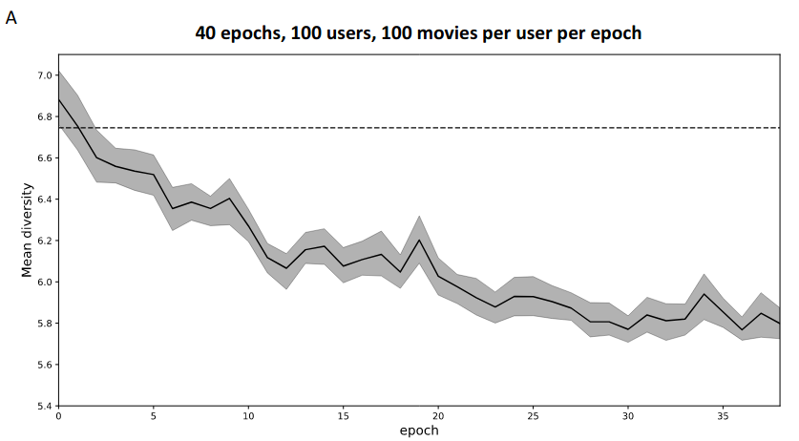
Literature review: Filter bubble/echo-chamber induced by recommendation systems (RS)
The role of RS in the echo-chamber effect:
“The collaborative-filtering mechanism captures the users’ preference by creating feedback loops, leading to system degeneracy.”
User
U
Item
I
Figure from Chen, YC., Hui, L. & Thaipisutikul, T. A collaborative filtering recommendation system with dynamic time decay. J Supercomput 77, 244–262 (2021). https://doi.org/10.1007/s11227-020-03266-2
Collaborative-filtering propagates similarities of items through the choices of the users:
Sim((i1, i2), t) ← Sim((U(i1), U(i2))), t-1)
Sim((u1, u2), t-1) ←Sim(I(u1), I(u2), t-2)
The recommendation is a map R: (u, t) → I*. Where the strategy could be expressed as
R(u, t) = I*, s.t. max Sim(I(u, [t-1, t-2, …, t-n]), I*)
The mean diversity of movie recommendations as the number of epochs increase. E. Noordeh, R. Levin, R. Jiang, and H. Shadmany, “Echo chambers in collaborative filtering based recommendation systems,” arXiv preprint arXiv:2011.03890, 2020.

Slide 6
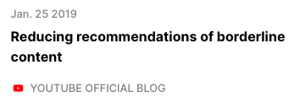
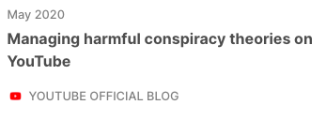
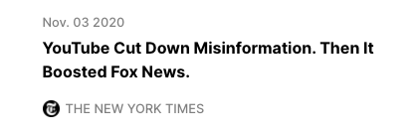
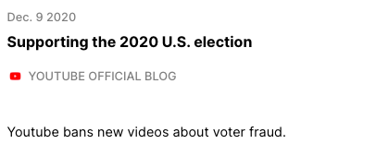
A brief history
AlgoTransparency,
Chaslot (ex-youtube-engineer), et. al.
“AlgoTransparency has been providing more transparency on which Youtube videos are the most recommended.
…our work illicit a positive reaction from YouTube. First it put wikipedia snippets under debated. Then, they took more than 30 measures to decrease the propagation of harmful disinformation, which resulted in a decrease of it by 70%.”
2018
2020.11
>. Our data collection began

Slide 7
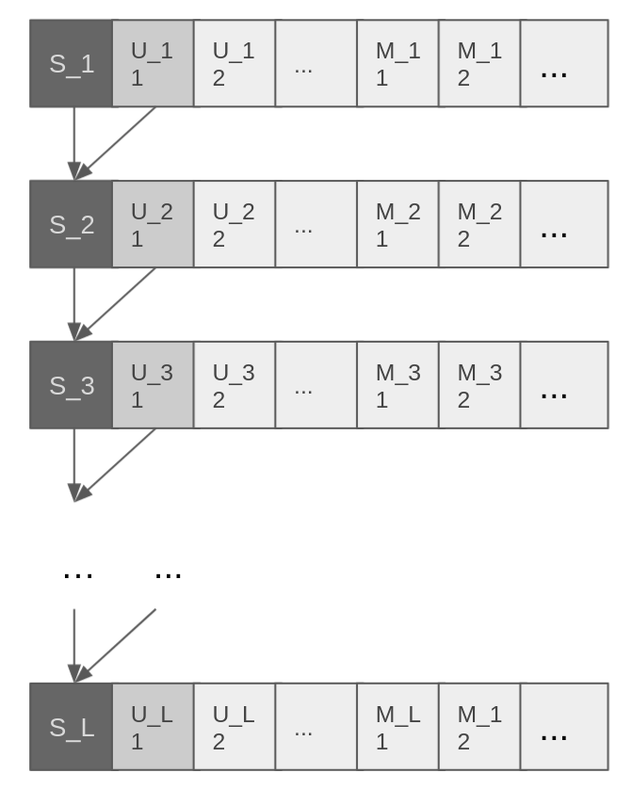
Our data collection
An anonymous user start from a channel S_1
The user click on the most recent video the channel published
Get recommendations as [U_11, U_12 …, M_11, ...] from “up next” recommendations and main page recommendations
Click on the first recommendation video and go to S_2 = U_11
Get recommendations as [U_21, U_22 …, M_21, ...]
...
(Up Next Recom.)
(Main Page Recom.)

Slide 8
Analogies with human mobility problems

Slide 9
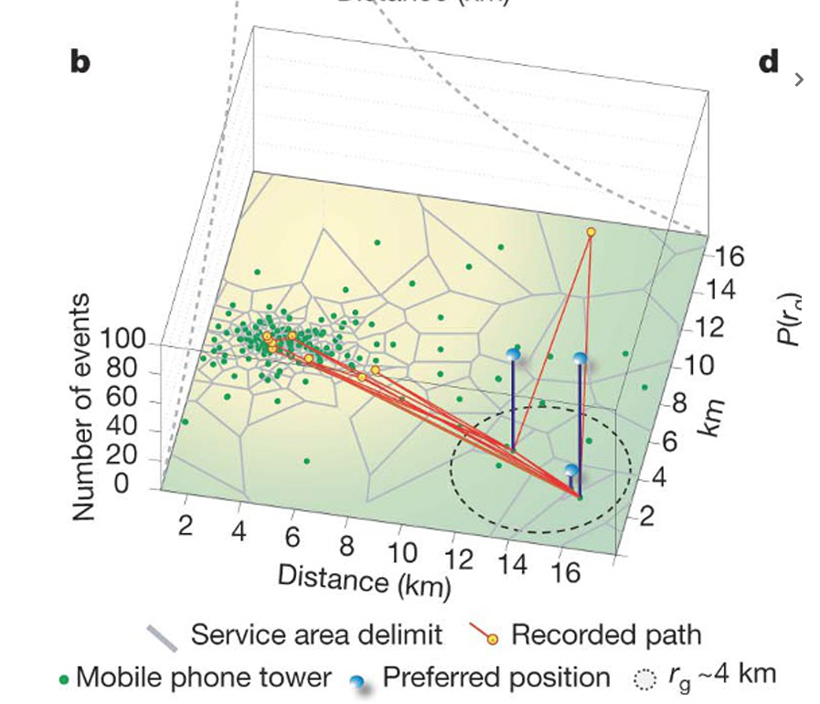
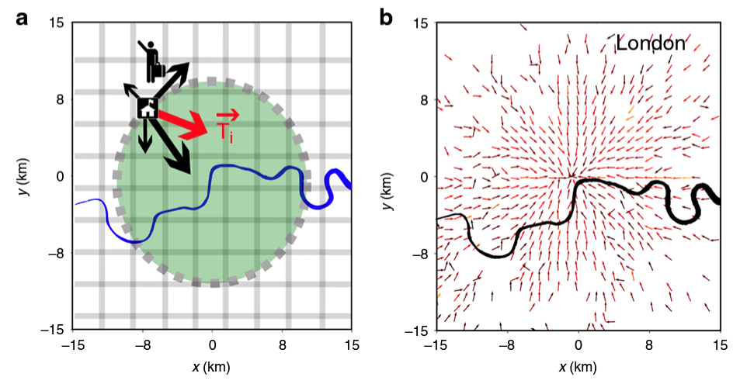
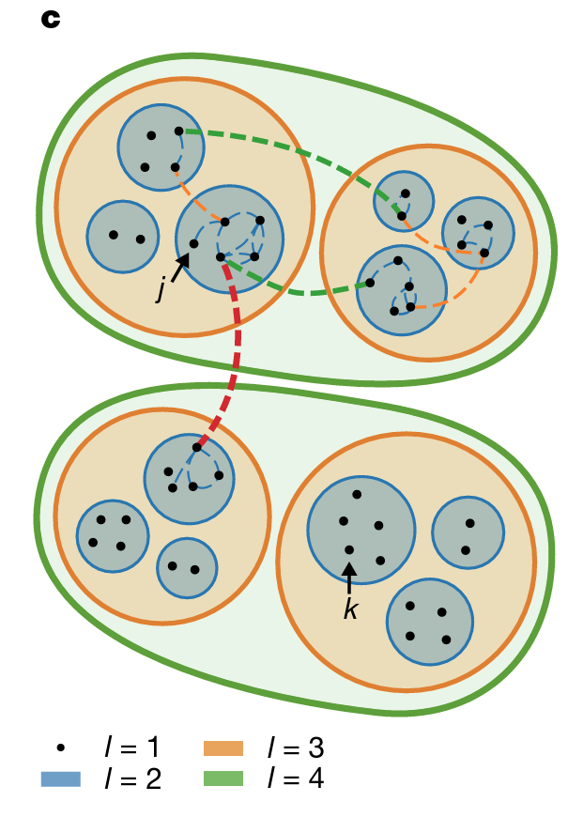
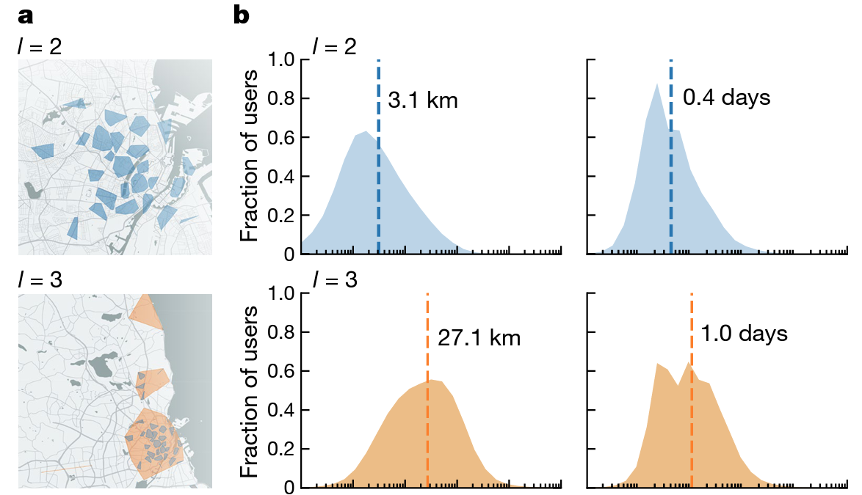
Comparison between the human mobility and the recommendation problem
19, Mattia, et. al
08, Marta et. al.
20, Laura et. al

Slide 10
Mobility problem | Youtube Recommendation problem
Known distance space: 2-d, 3-d space, fixed location, or easily determined location | Unknown distance space: unknown dimensionality, location hard to determine
Locations all observed | Unobserved locations existed
Low magnitude of no. of locations (~100-1000) | High magnitude of no. of locations (> 10,000)

Slide 11
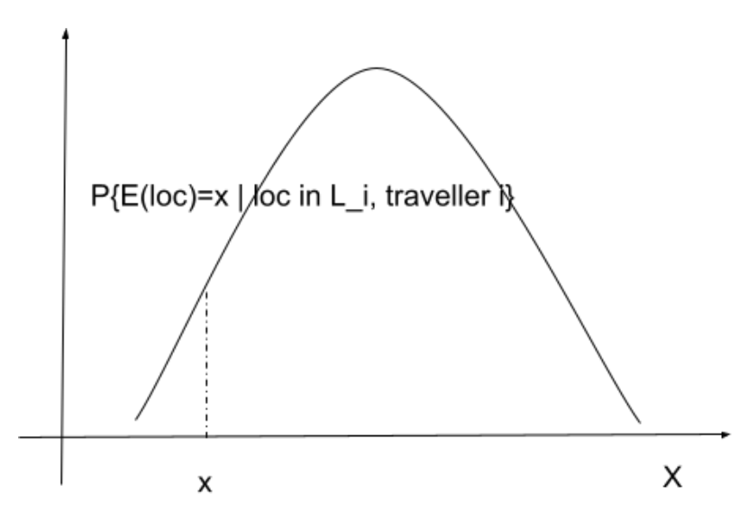
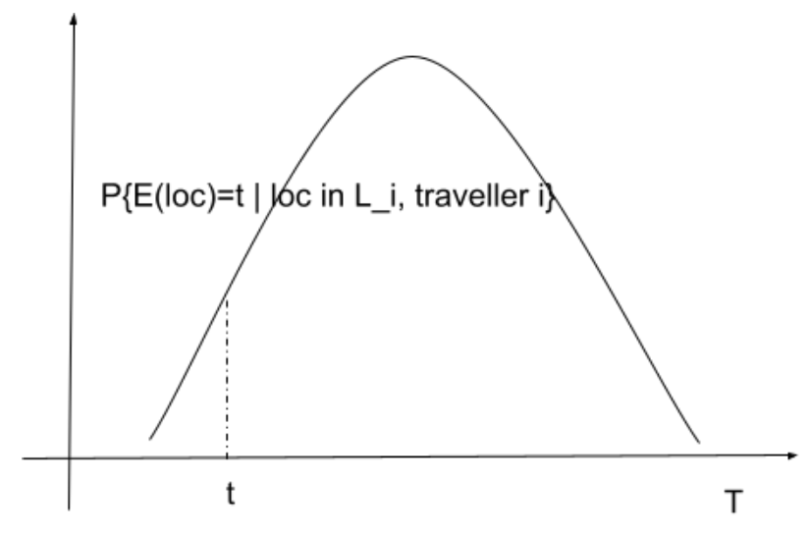
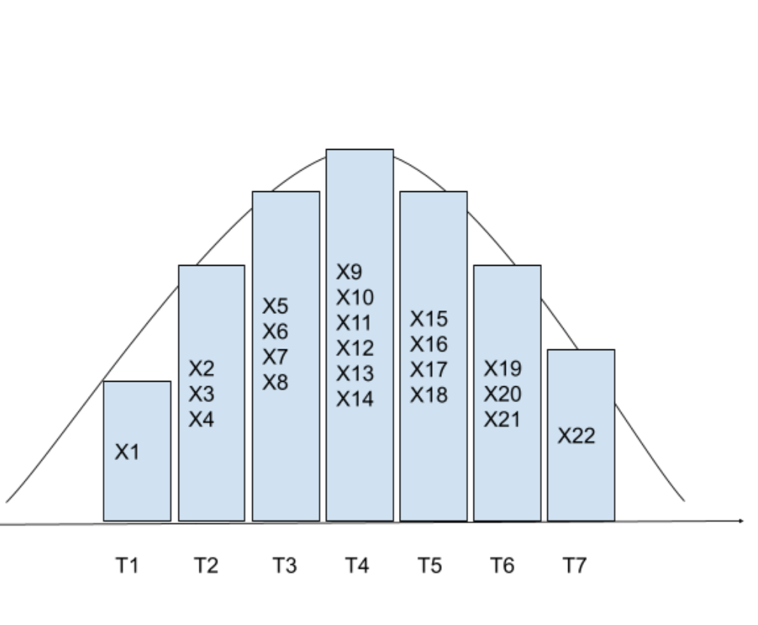
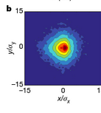
An analogy with the human mobility problem
One simple way to measure the “distance”
Human mobility; traveller’s location distribution at X
Youtube recommendation; traveller’s location distribution at T
Fig 3. (d) Gonzalez, Marta C., Cesar A. Hidalgo, and Albert-Laszlo Barabasi. "Understanding individual human mobility patterns." nature 453.7196 (2008): 779-782.
Data: The traveller starts from Fox news

Slide 12
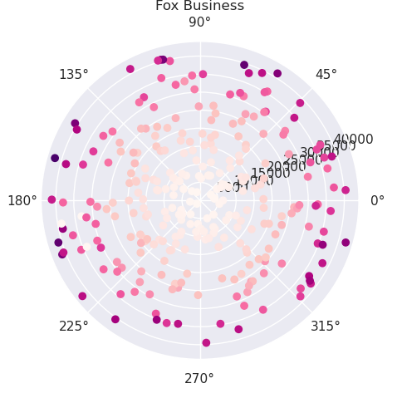
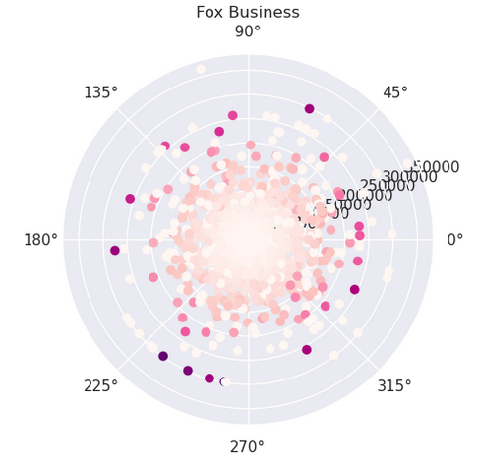
Perspective Universe
From each seed, get its perspective universe
For each node n in the universe:
Def.
‘in-traffic’: # of n->m, where m in core|seed
‘Out-traffic’: # of n->m, where m not in core|seed
(Noise reduction:
Only keep the nodes where total_traffic > N, to reduce the small sampling noise
)
Small sampling noise: low total traffic

Slide 13
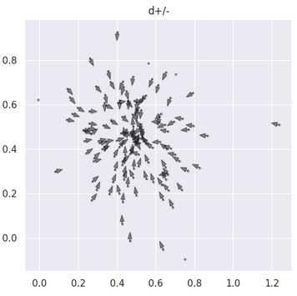
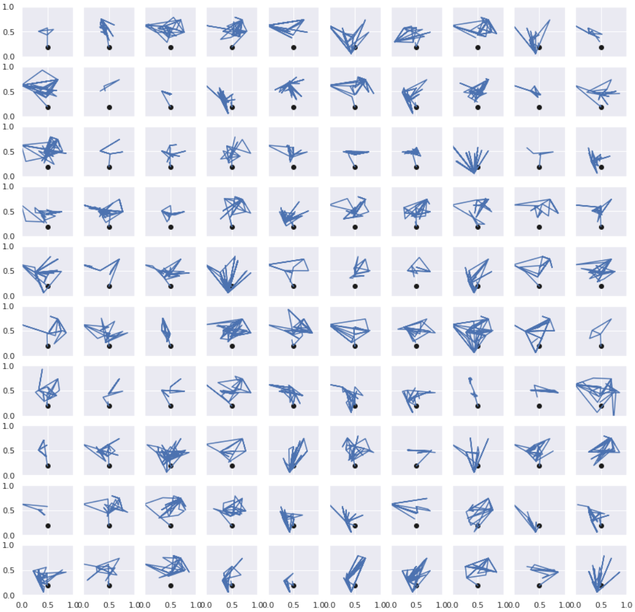
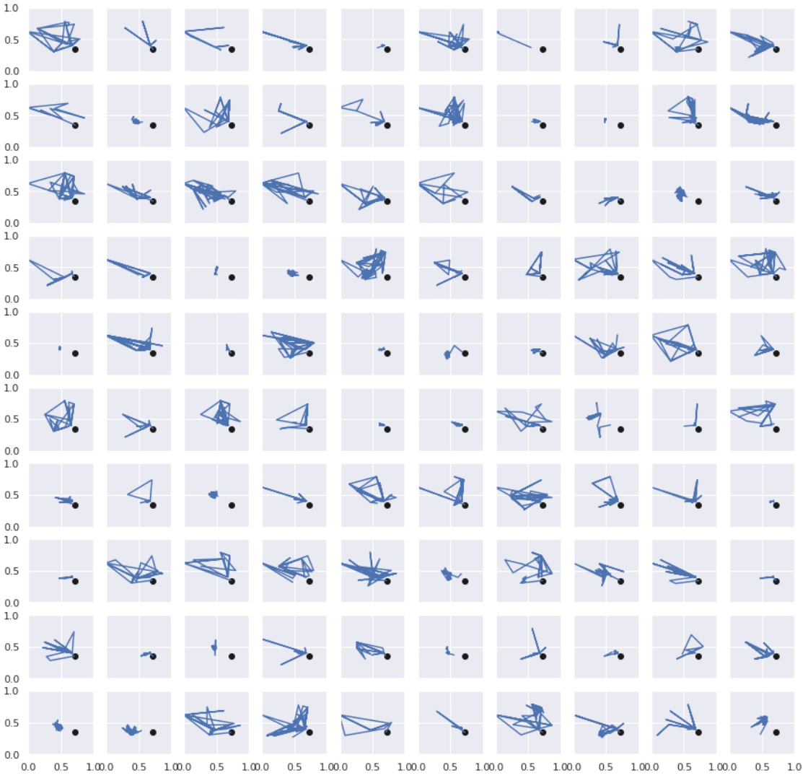
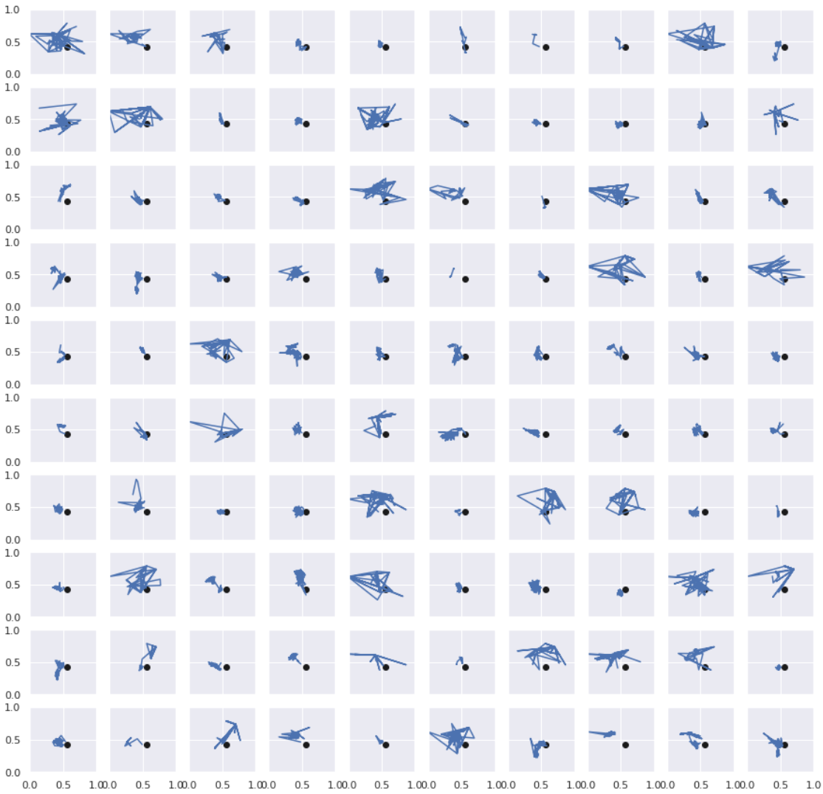
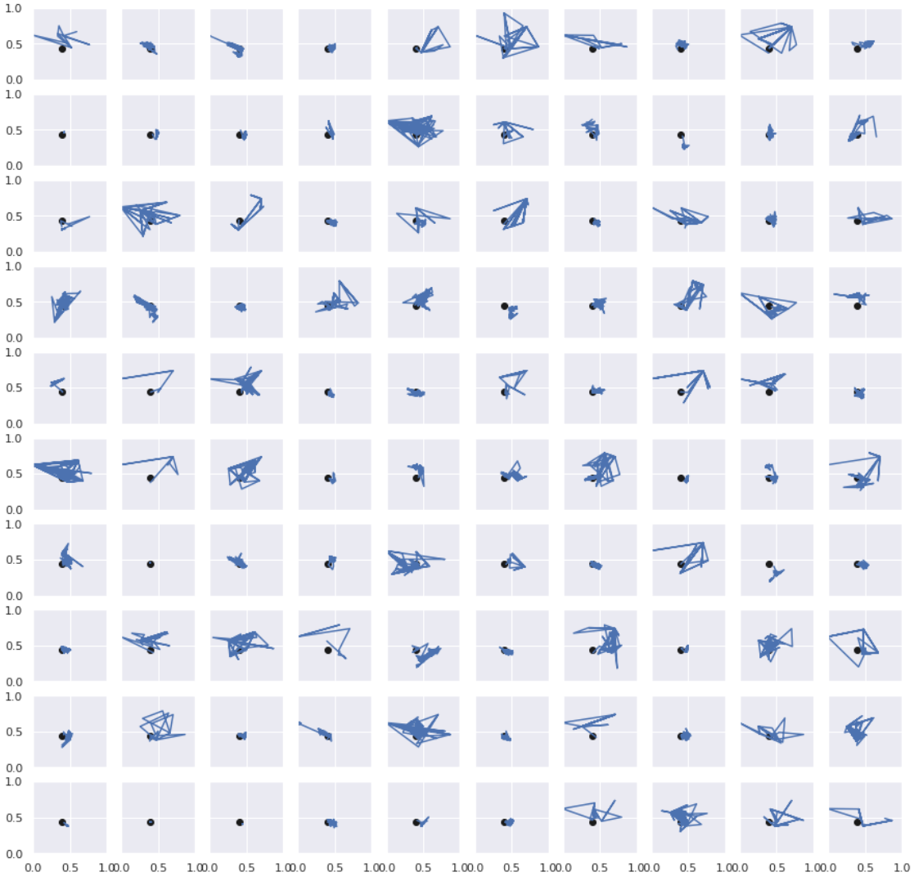
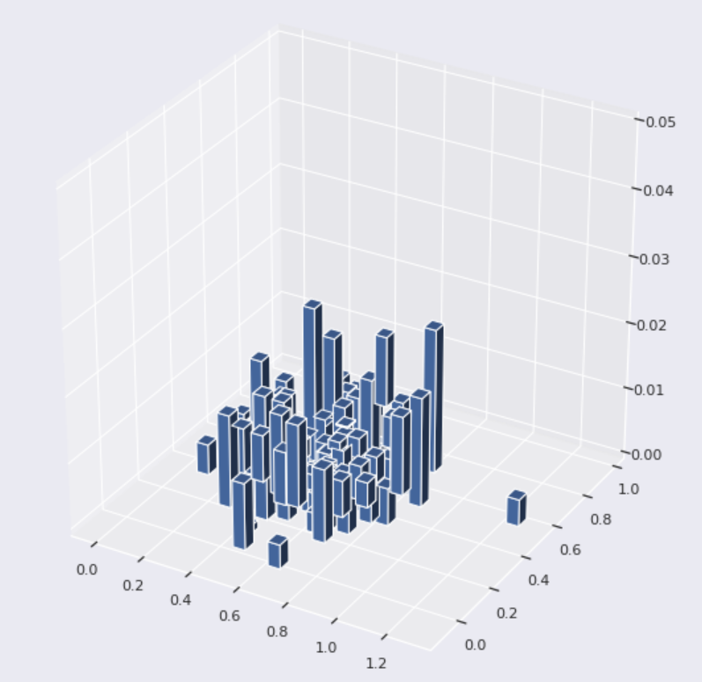
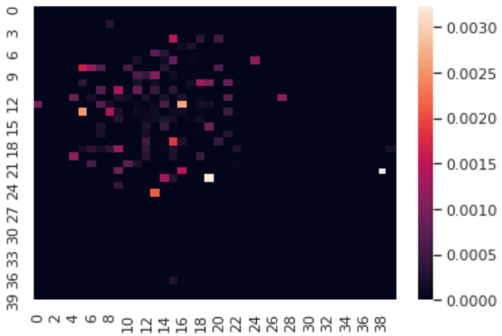
Trajectory Visualization (on 2-d embedding)
Distribution of the avg. trajectory std. starting from some seeds at (x, y);
Notes:
Check x^2: step 2
Fluctuation at certain point

Slide 14
Looking into possible filter-bubbles

Slide 15
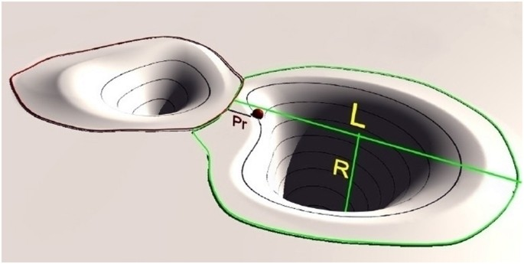
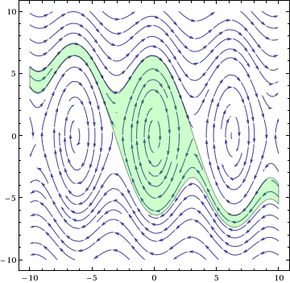
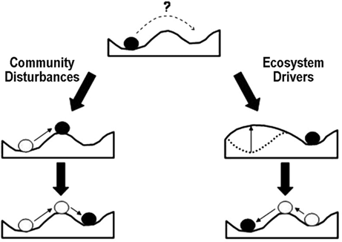
Resilience Problem Formation
According to the preliminary experiments, we would model the event of the user interacting with the RS as traversing the space of multiple basins of attraction
Mitra, C., Kurths, J. & Donner, R. An integrative quantifier of multistability in complex systems based on ecological resilience. Sci Rep 5, 16196 (2015). https://doi.org/10.1038/srep16196

Slide 16
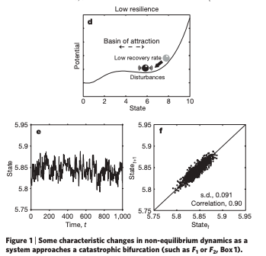
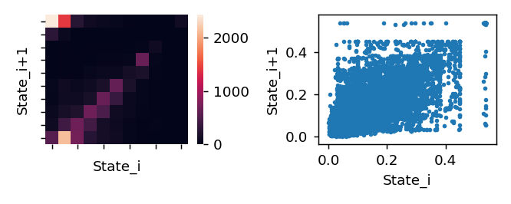
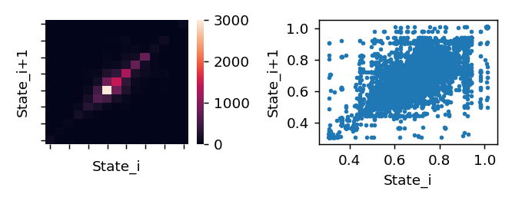
Single potential well hypothesis:
2-d embedding
Hessian LLE
2009, Nature, “Early Warning Signals for critical transitions”

Slide 17
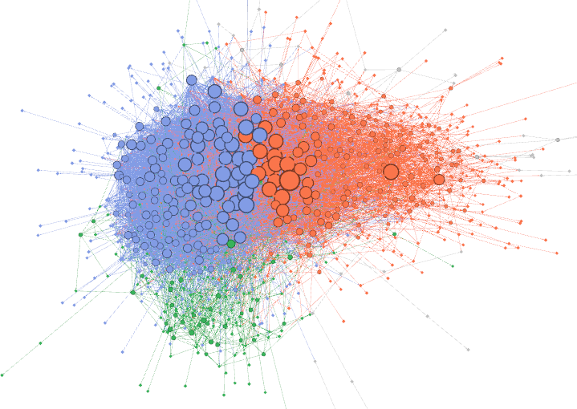
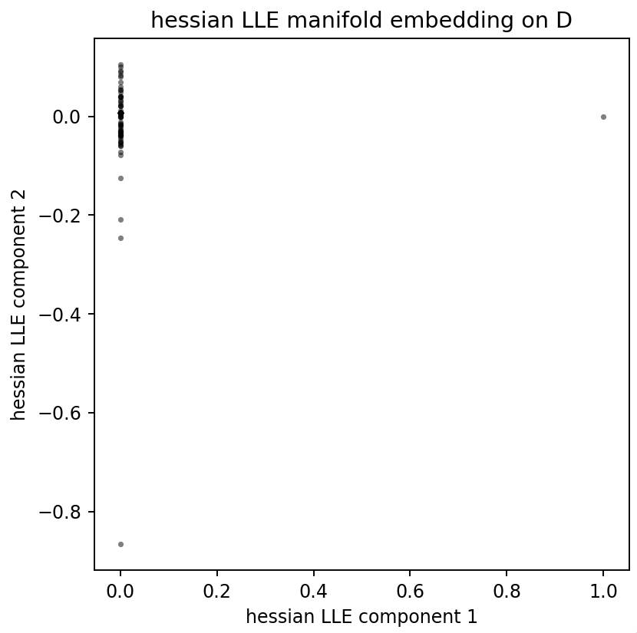
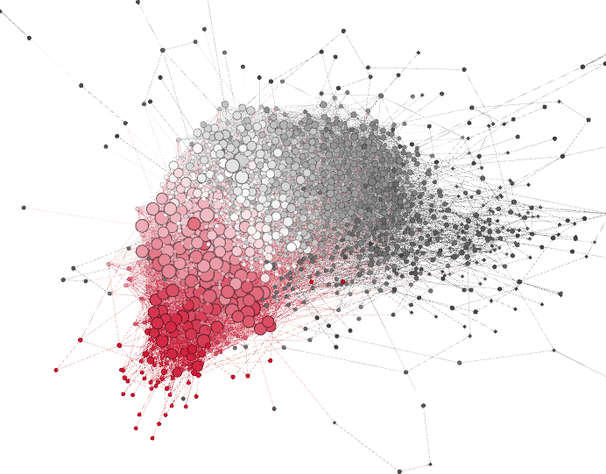
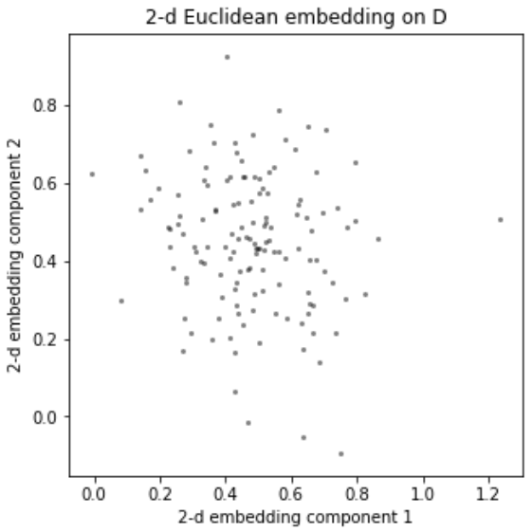
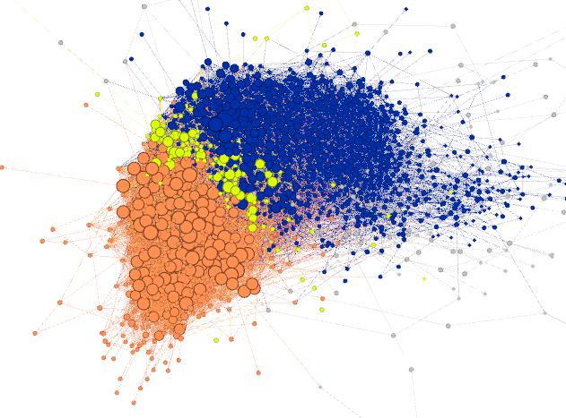
Trajectories in a reconstructed state-space
Delayed-Coordination Embedding [Takens, 1980]
For a state-space of E state variables, it suffices to create d_E = 2*E+1 dimensional Delayed-Coord. Embed from the 1-d sensor observation, and the reconstructed trajectory are topological equivalent to the original one.
From preliminary analysis, our data behaves like 1-d, therefore we set d_E=3=2*1+1, and create the following Delayed-Coord. Embed.: X(t)=(x(t), x(t+1), x(t+2)), where x(t) is the value at time step t in the 1-d time series
For 2-d Eucli. The 1-d sensor is set as ||·||_2 distance from center (.5, .4)
loc-shift transition network clustering analysis
Demo: Grids in the embedding space as nodes in the transition network
j1
j2
i1
i2

Slide 18
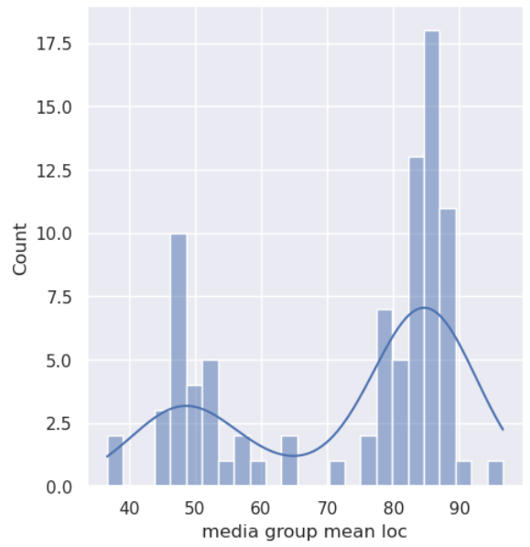
Media coverage data projected onto the embedding space
Talk shows, commentary
Major news outlet
[[1, 1, 1, 0, …],
[1, 0, 1, 1, …],
…]
media coverage data
-> channel encoding matrix

Slide 19
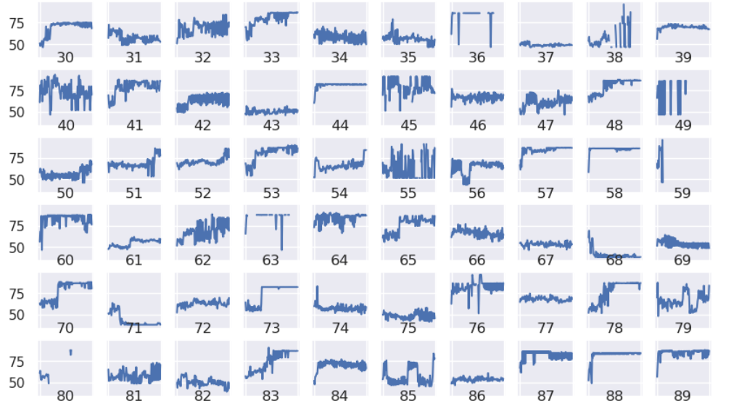
Demo of a trajectory in the embedding space

Slide 20
Still exploring… To be continued!

